Slide 1
Stress Detection from Social Media Articles
Oliver Sun, Garvin Huang
Prof. Linda M. Sellie
2:00 PM Section
CS-UY 4563

Slide 2
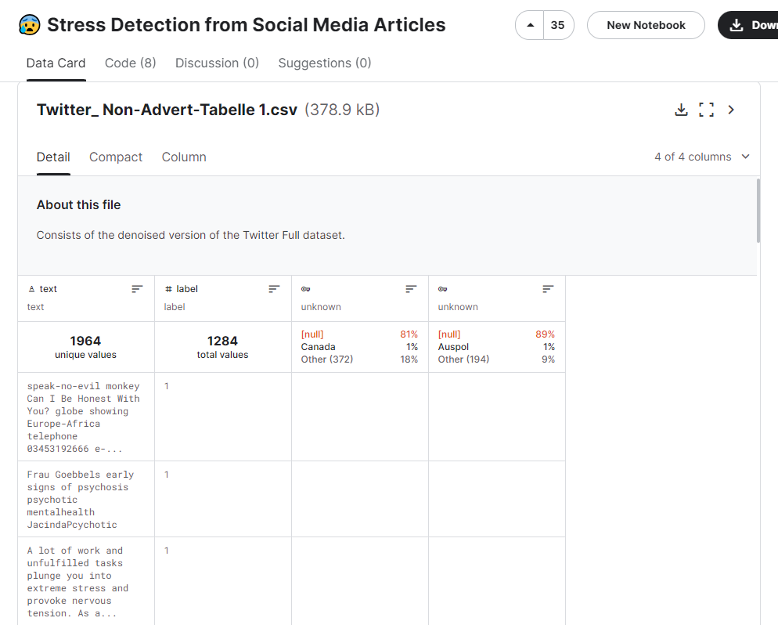
Introduction
Dataset is from Kaggle. Other data includes information from Reddit, but today we are looking at the Twitter No Ad Dataset.
1640 Training
411 Validation
https://www.kaggle.com/datasets/mexwell/stress-detection-from-social-media-articles?select=Twitter_+Non-Advert-Tabelle+1.csv

Slide 3
Preprocessing
Text needs to be processed to remove extraneous elements
Includes punctuation, capitalization, and stemming
All text stripped of punctuation and made lowercase
Word stemming
Reduces word to root form
e.g. thinking -> think
Notes:
tfidf = term frequency inverse document frequency

Slide 4
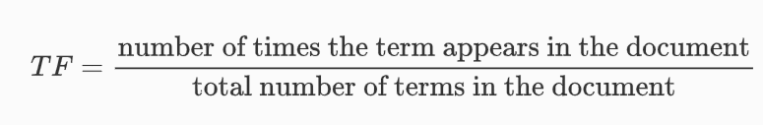


Transformations
Bag of Words (BOW):
Convert each document into a vector with N features
N = # of unique words
Value of each feature = Frequency of that word in that specific document
Term Frequency-Inverse Document Frequency (TFIDF):
https://www.learndatasci.com/glossary/tf-idf-term-frequency-inverse-document-frequency

Slide 5
Logistic Regression
Used both BOW and TFIDF transformations along with L1 and L2 regularization
C Values: 0.0001, 0.001, 0.01, 0.1, 1, 10 ,100
Best model used a TFIDF transformation with L2 regularization with C = 100
The model had an accuracy of 81.98 percent

Slide 6
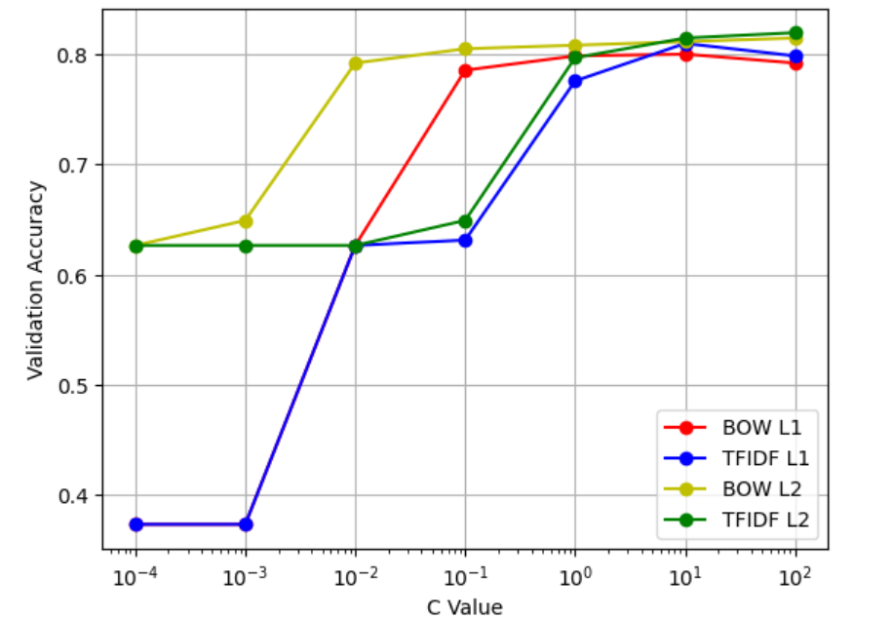

Slide 7
Conclusion (Logistic Regression)
Regularization was the deciding factor
Text based data results in higher variance models
Having a “strong” regularizer makes model more stable and accurate
Best Accuracy: 0.820

Slide 8
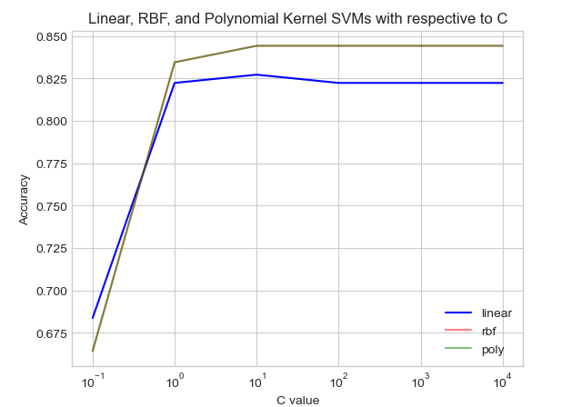
SVMs

Slide 9
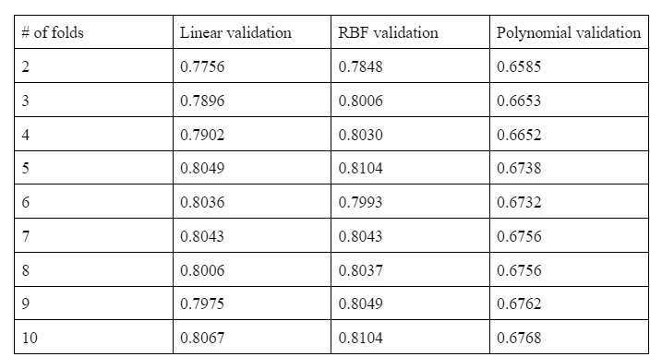
K-fold Cross Validation

Slide 10
Conclusion (SVM)
All three kernels showed worse accuracy
RBF best overall, linear 2nd with polynomial last
Unexpected - usually linear is best
Could be because of variance - discrepancy between linear and RBF are very very close
Best Accuracy: 0.844

Slide 11
Neural Network
Tested 3 different activation functions alongside 3 different neural network architectures
Activation Function for Outer Layer: Sigmoid
Activation Function for Hidden Layers: Sigmoid, ReLu, tanh
Architecture: 1 hidden layer with 100 neurons, 1 hidden layer with 10 neurons, and 10 hidden layers with 100 neurons

Slide 12
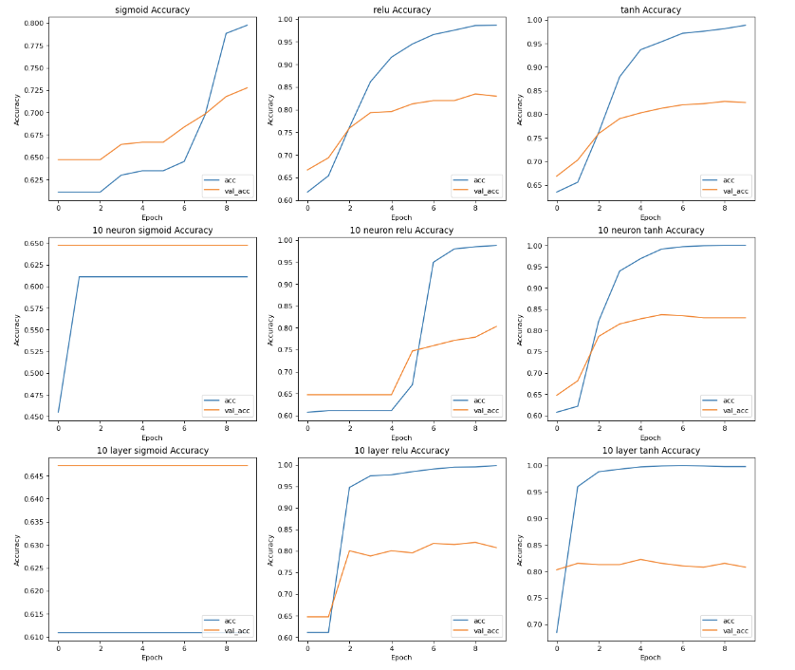
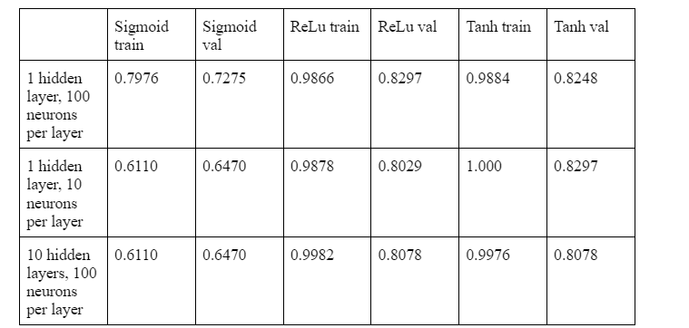
Neural Network
Best Accuracy: 0.8297

Slide 13
Final Conclusion
Improvements
-Experiment with further feature transformations in SVM, like bag of words and Word2Vec
-Use undersampling and oversampling to create more balanced data set
Highest Accuracy: 0.844 with RBF Kernel SVM

Slide 14
Works Cited
https://www.kaggle.com/datasets/mexwell/stress-detection-from-social-media-articles/data
https://scikit-learn.org/stable/modules/generated/sklearn.linear_model.LogisticRegression.html
https://scikit-learn.org/stable/modules/generated/sklearn.svm.SVC.html
https://github.com/zafirhsn/machine-learning/blob/master/FinalProject_Log%2BSVM.ipynb

